Slide 1
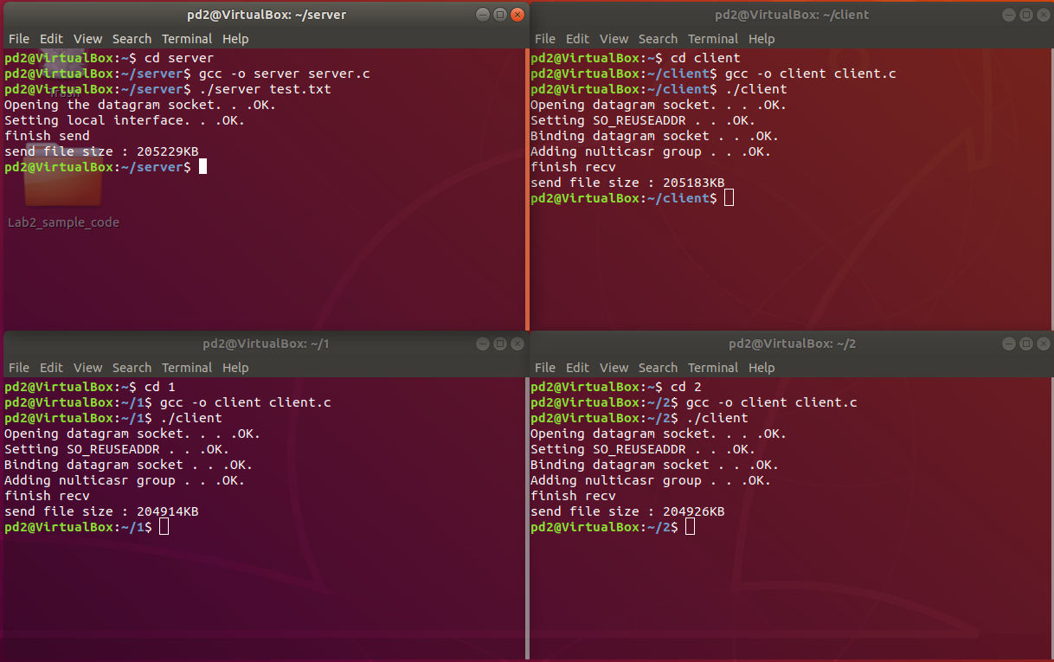
Multcast
傳輸結果

Slide 2
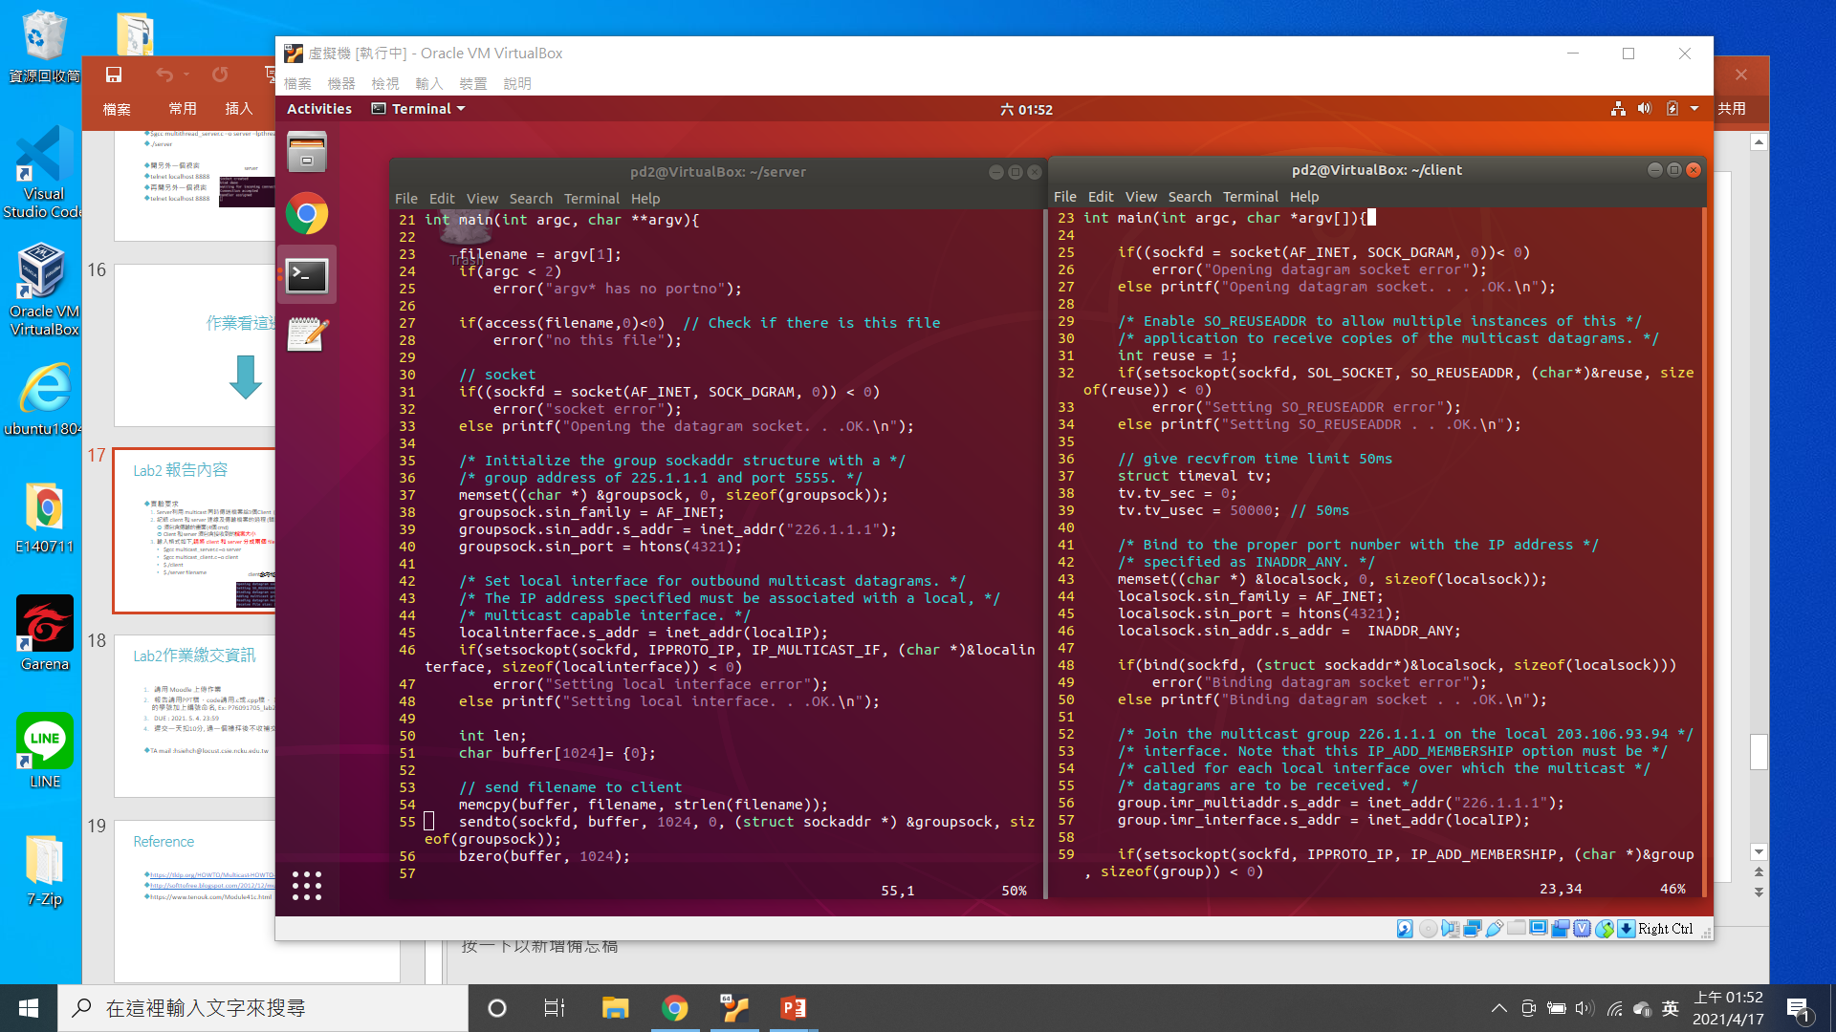
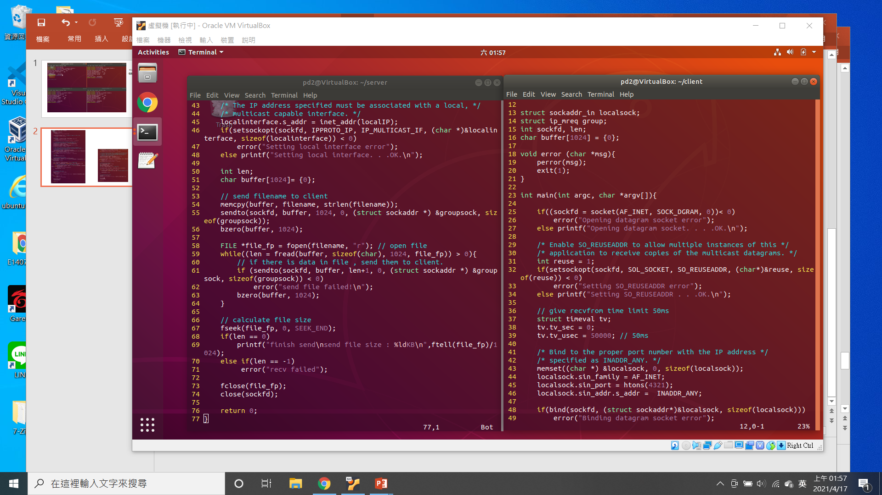
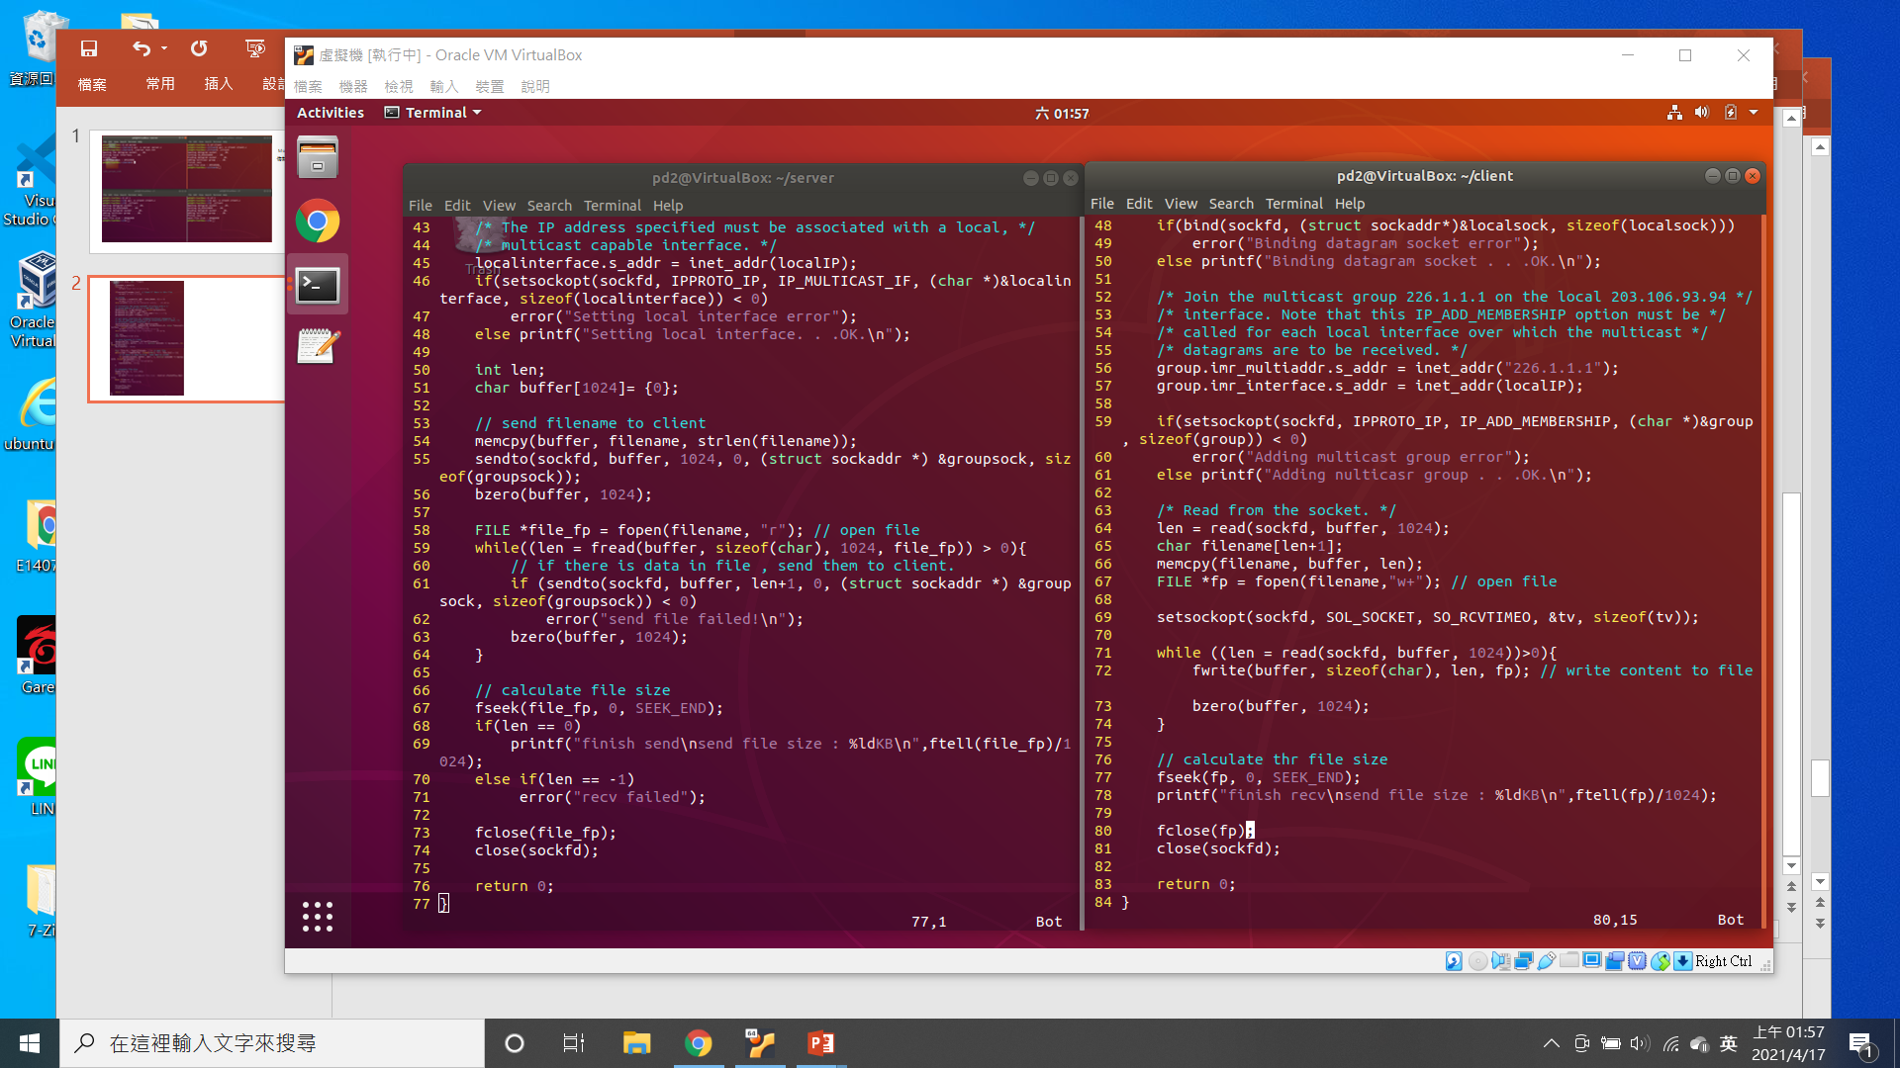

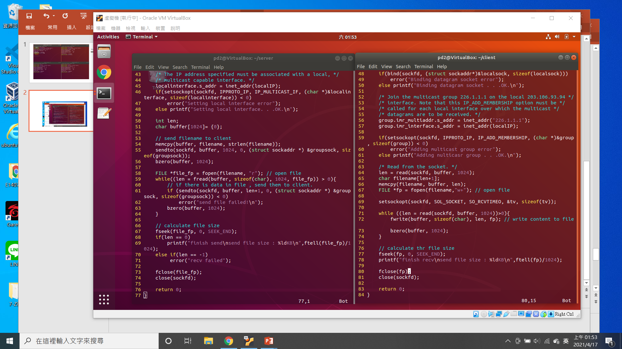
Udp socket
Udp socket
Set local interface
Bind
Adding multicast group
Send data
Recv
(when read file name , set the time limit)

